Slide 1
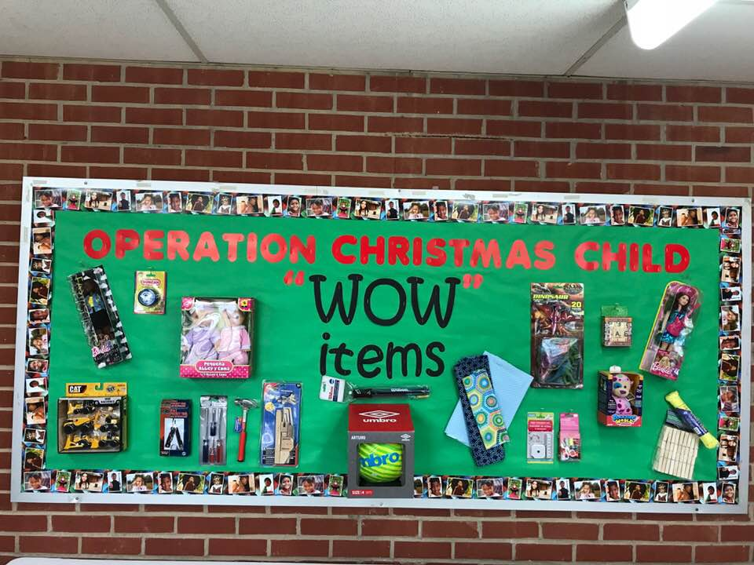
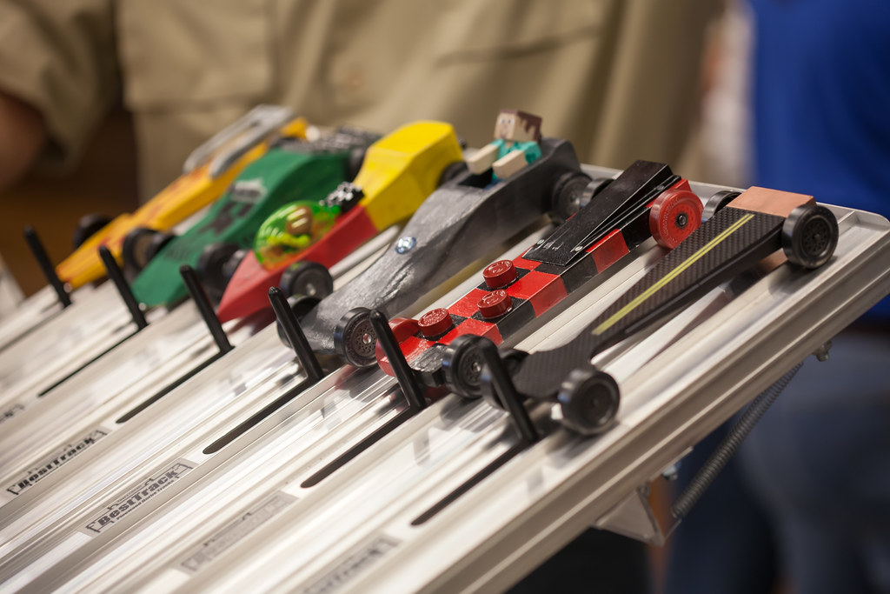
April 14, 2024
Announcements Deacon of the Week
Congregation Lord I Life Your Name On High
God Is Able
When I Survey The Wonderous Cross Special Harvey Beard
Message Looking Toward the Cross Pastor Randy Moore
John 12:27-41
Invitation Lord I’m Coming Home Hymn 309 Prayer Deacon of the Week: Cleo Russ
Pianist Carolyn Haire
Ministry Opportunities of the Week
Sunday, April 14th
9:30am Choir Practice
10:00am Sunday School
11:00am Worship
4:45pm AWANA
5:00pm Rooted Youth
Adult Bible Study
6:30pm Choir Practice
Wednesday, April 17th
5:45pm Praise Team Practice
7:00pm Worship on Wednesday
8:00pm Choir Practice
Thursday, April 18th
7:00pm AWANA workshop for grand prix
Saturday, April 20th
8:00am Band of Brothers
Circle of Sisters
Pastor Randy Moore
(910)658-1149
Please call or text if you need anything
Sign Up Sheet is at the Welcome Desk
We need your help
We still need teachers for K-1, 2-3 and Youth
Dates for VBS June 23-27
Next Meeting Tues May 7th
T-shirt orders and money due See Tausha
Missions Focus for March & April
WOW Items for Christmas Child Shoe boxes
Attention Senior Adults
2024 Senior Adult fun day is Thurs May 9th from 9-12 at Piney Grove Baptist Church
Special Guest: Scott Mason from Tarheel Traveler
If you are interested please see Tausha Beard or Pastor Randy
Deadline to register is Sunday April 28
Cost is 10.00
AWANA Grand Prix
Friday April 26th 6pm
Open to the Church
Workshops April 11,18,25 7pm
Cars $5.00
Children’s Church
Preschool-4th Grade
Meet at back after Choir Sing
April 14 Tina
April 21 Tausha
April 28 Kathy
Nursery Volunteers for April
April 14 Lauren
April 21 Dawn L
April 28 Dawn M
Office: 910-436-0276 • 4575 Ray Rd. Spring Lake, NC, 28390
gourdsprings@gmail.com • www.gourdsprings.com

